Slide 1
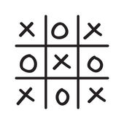
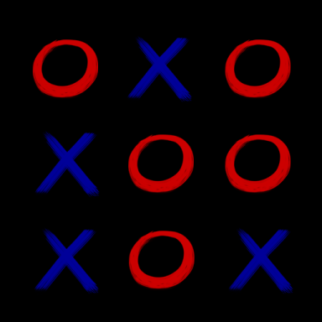
Tic Tac Toe
Mak Verma
Jarett Murphy

Slide 2
Goal
Our goal was to use our knowledge of C++ from the entire year and collaborate as a team to make a game to demonstrate our understanding of coding.

Slide 3
Difficulties
The graphics portion was a bit difficult because we didn’t know how to start it off
For example, we had trouble creating the grid of the game

Slide 4
Structure
There is a 3 x 3 grid and 2 players must play this game.
X is red
O is blue
The 2 players alternate turns and the player with 3 in a row wins.
If no one wins the round, the game is called a draw.

